Slide 1
Weekly update
2/26/2024

Slide 2
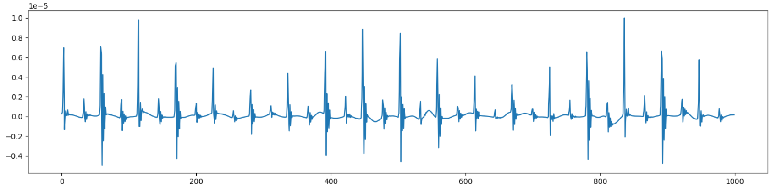
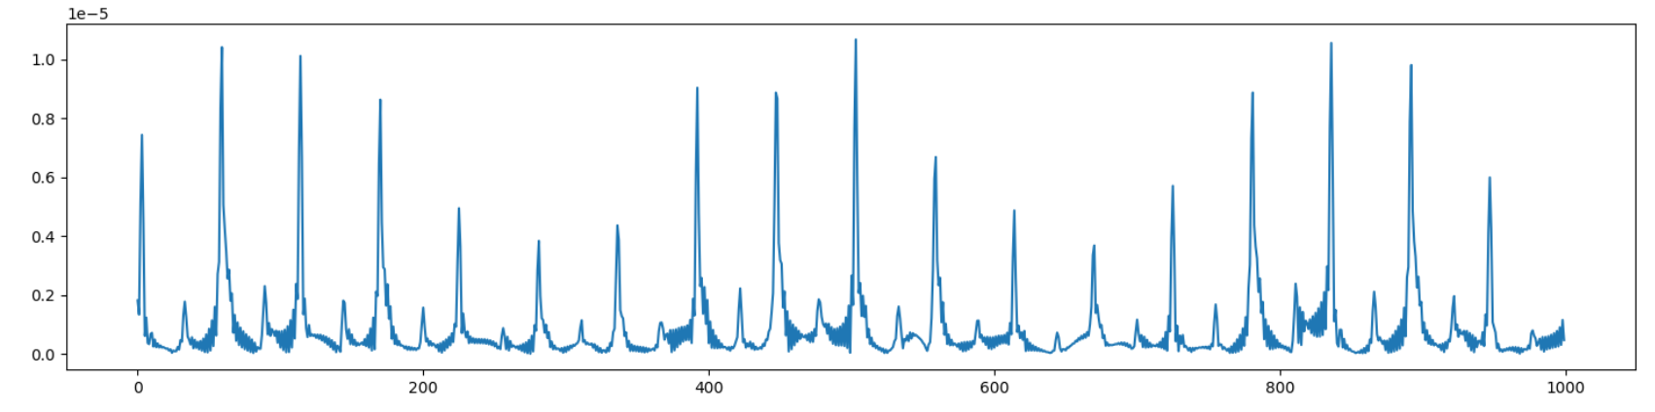
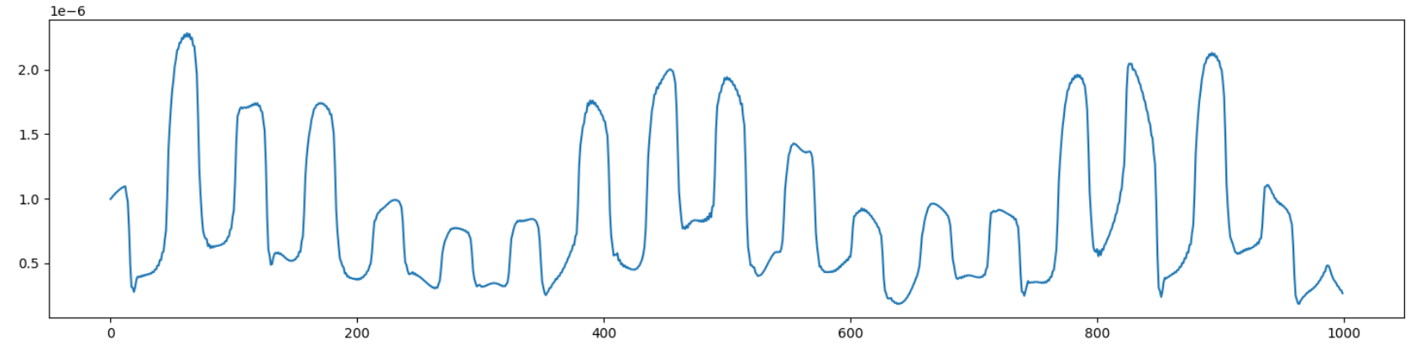
Data_process
Input data (1000,1)
envelope = np.abs(hilbert(signal))
Cal Envelop
Moving Average
windowsize=25
Transformer

Slide 3
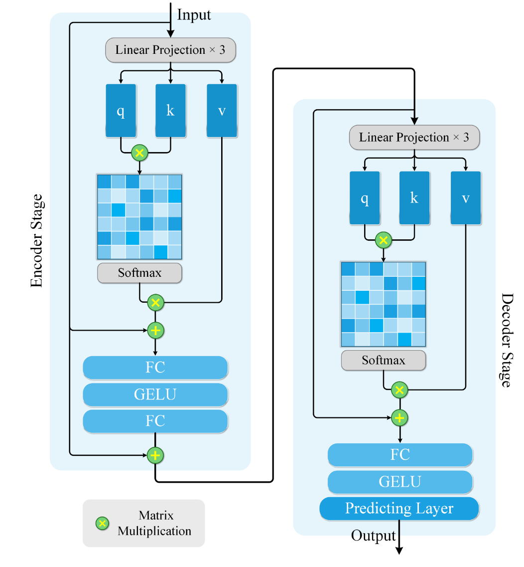
Model

Slide 4
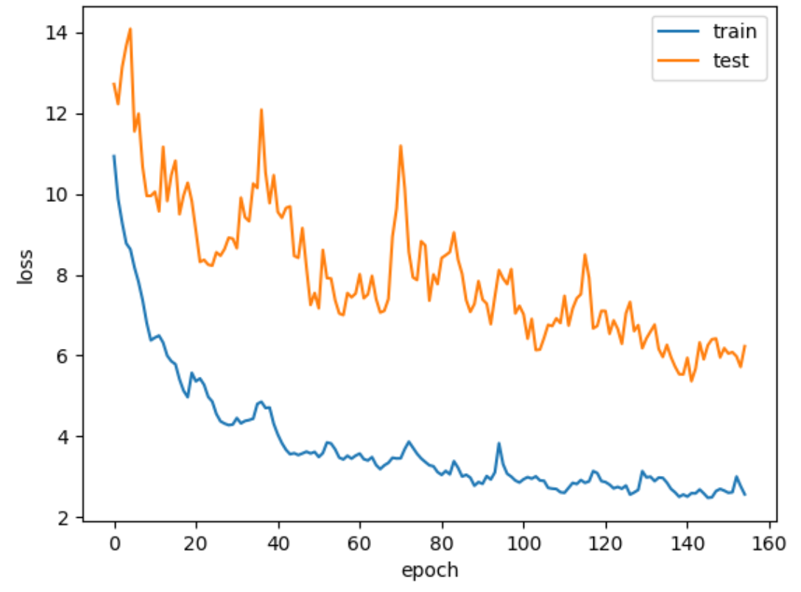
Result
Split train set

Slide 5
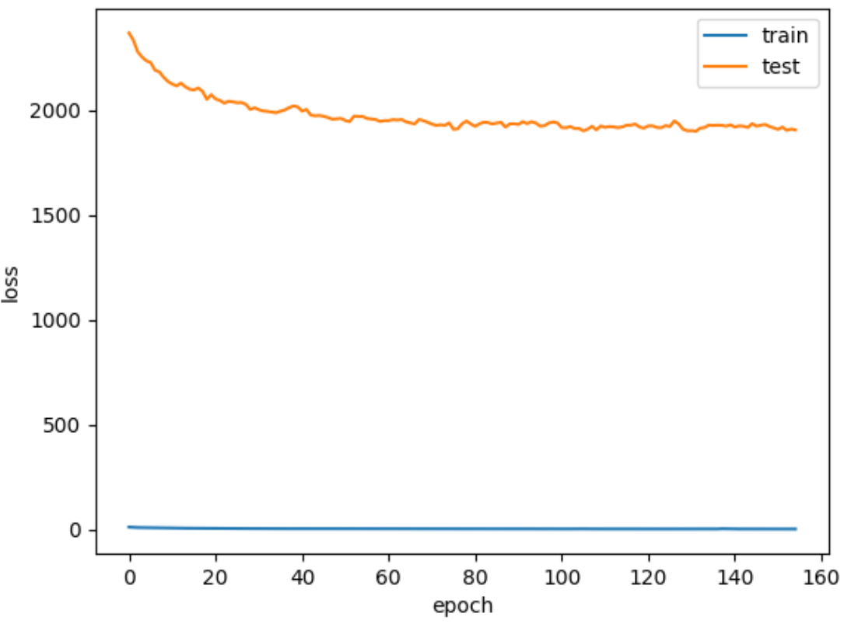
Result
Train / test set

Slide 6
THANKS

